Slide 1


UNDERSTADING THE LANDSCAPE OF
DIABETES HEALTH INDICATORS & RISK FACTORS

Slide 2

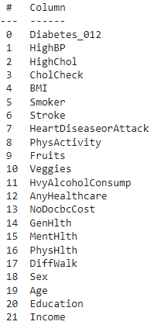
ABOUT
THE DATASET
The data has been collected from the state of USA for the year 2012. It has 253,680 entries and 22 Features.
We have various health indicators such as blood pressure, cholesterol levels, BMI, smoking status, physical activity, mental and physical health, and demographics like age, sex, education, and income.

Slide 3
THE
TARGET VARIABLE
As we are examining the Risk factors and Diabetes health indicators, so in all, our target variable is `Diabetes_012`, represents the diabetes status
  0 - no diabetes
  1 - prediabetes
  2 - diabetes

Slide 4
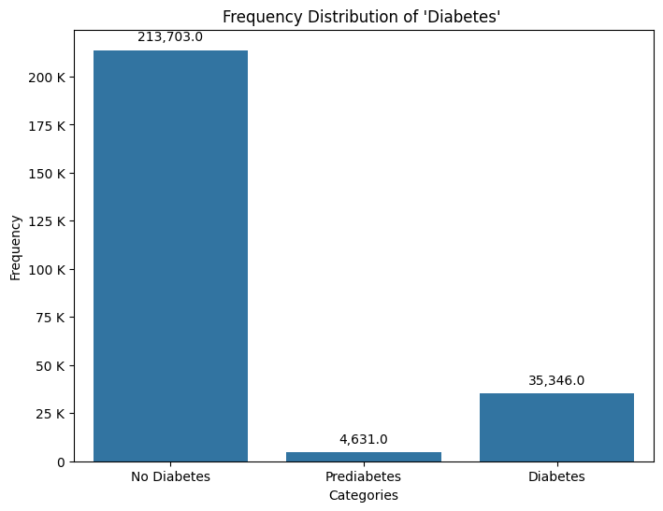
The target variable Diabetes shows the distribution of diabetes status in the dataset:
  The majority (84%) of individuals do not have Diabetes.
  There are fewer cases of Prediabetic (2%) and Diabetic (14%) symptoms compare to No Diabetes category .

Slide 5
Based on initial understanding, the following points to be consider:
  There are several binary health indicators (HighBP, HighChol, CholCheck) that could be important predictors of diabetes.
  Demographic variables like Sex, Age, Education, and Income are present and might provide valuable insights.
  BMI could be a significant predictor, given that obesity is a known risk factor for diabetes.
  Mental and physical health indicators (MentHlth, PhysHlth) might also play a role in diabetes risk.
Let’s focus each

Slide 6
Diabetes Health Indicators

Slide 7
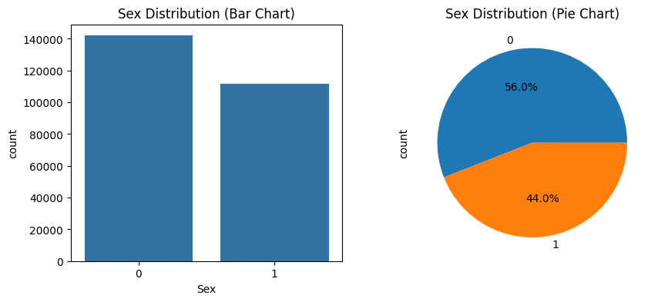
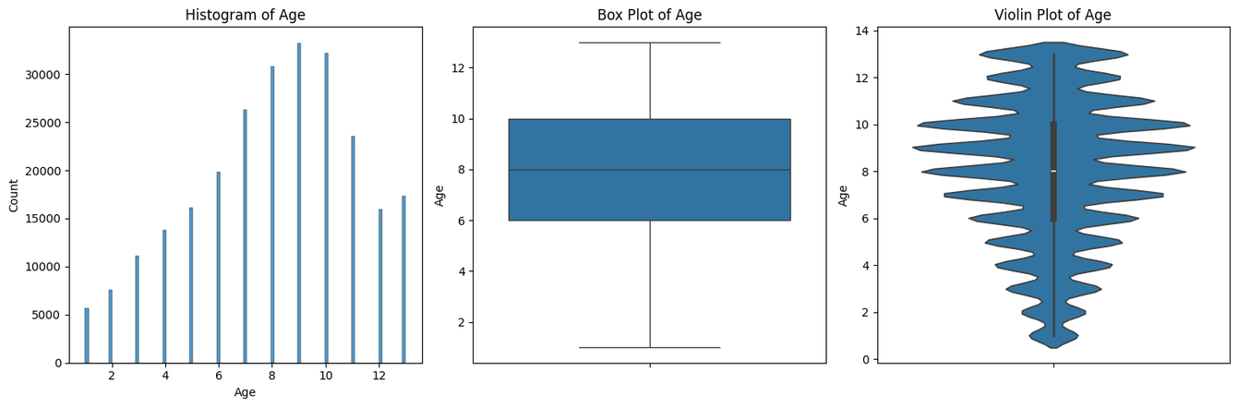
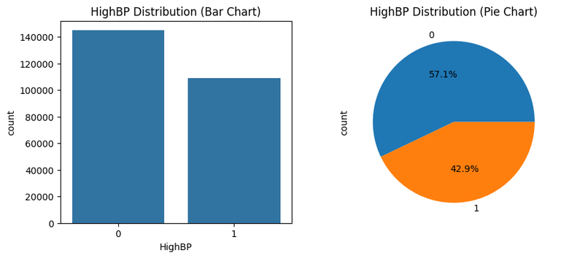
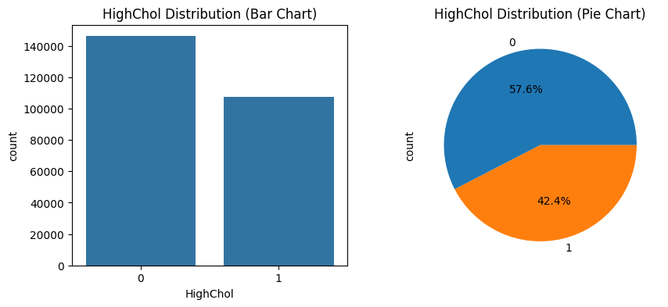
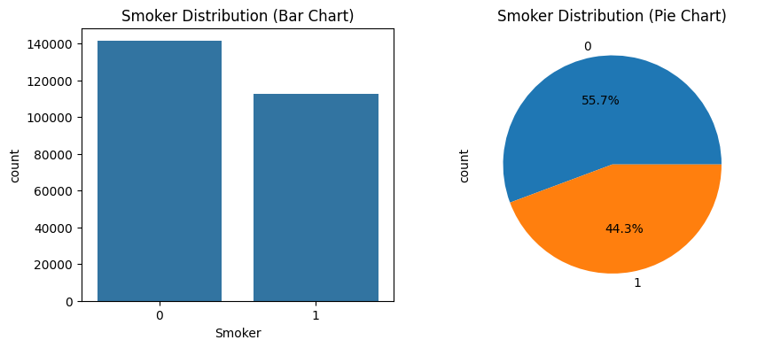

  The gender distribution have majorly female (56%) out of total and rest are male.
  The population is predominantly middle-aged, with the majority concentrated between 50 and 74 years, indicating a mature demographic. Age range extends from about category 1 (18-24 years) to 13 (80 or older).
  Around 43% of the population has high blood pressure, with a higher prevalence among those with diabetes.
  Around 96% individuals have checked their cholesterol in which more than 40% of the population has detected high cholesterol among individuals with prediabetic and diabetic.
  Around 44% of individuals have a history of smoking. Smoking prevalence is higher in individuals with diabetes

Slide 8
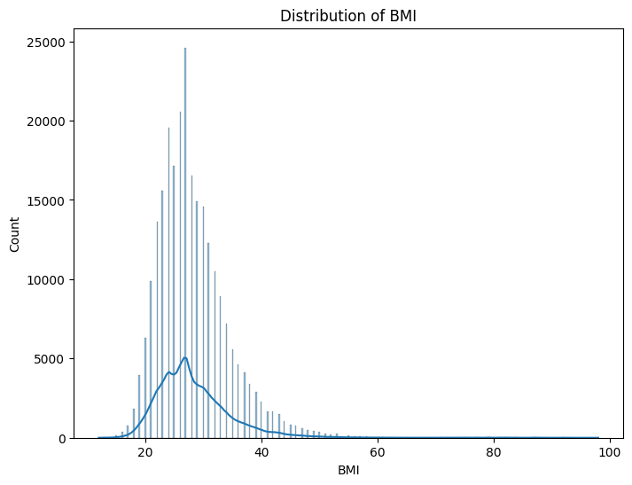

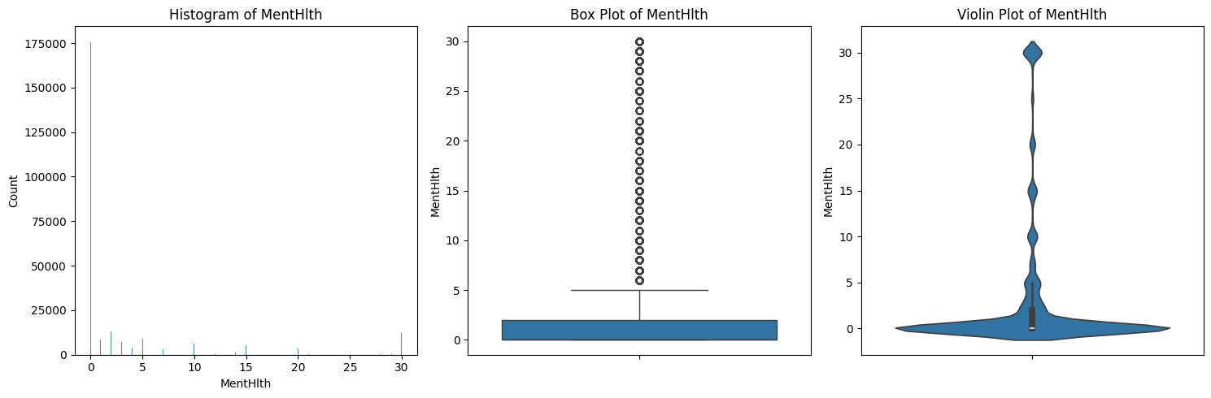
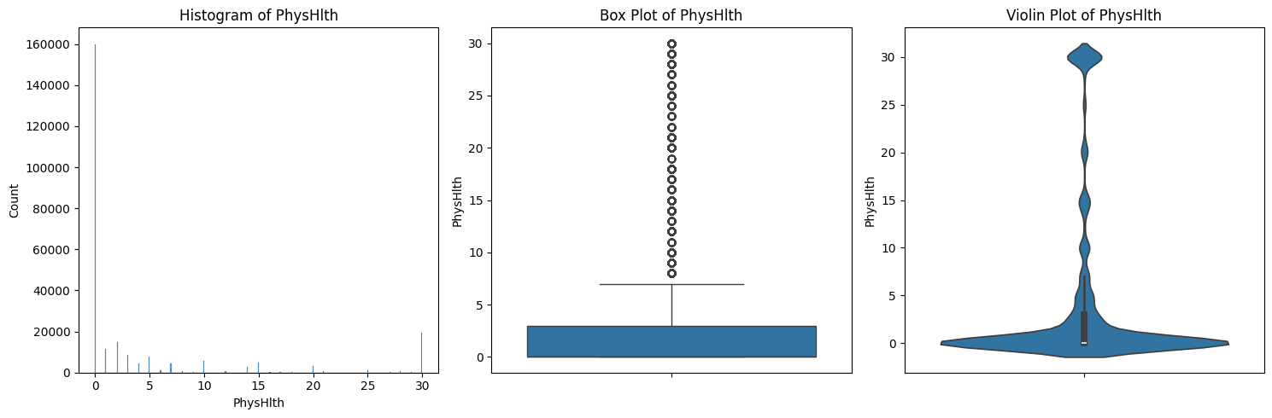
BMI
Most of the population falls within normal to slightly elevated BMI levels (20 to 35), there are a few cases of severe obesity with BMI values exceeding 40..
PHYSICAL & MENTAL HEALTH
Both physical and mental health data exhibit similar patterns of skewness and distribution. While the median for both datasets is around 3, there is a significant spread of scores, suggesting that individual experiences of health vary widely.

Slide 9
Key Risk Factors and their Relationship

Slide 10
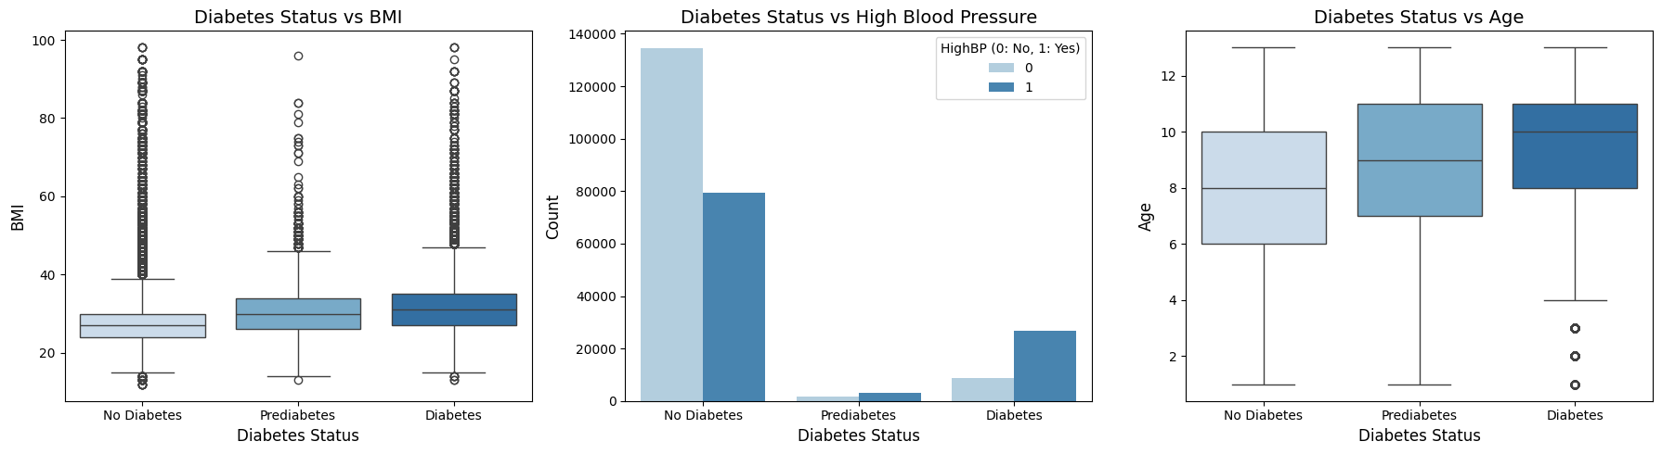
RELATIONSHIP BETWEEN DIABETES STATUS AND THREE VARIABLES: BMI, HIGH BLOOD PRESSURE, AND AGE
The analysis suggests that individuals with diabetes tend to have higher BMI, higher blood pressure, and be older compared to those without diabetes or with prediabetes.

